Slide 1
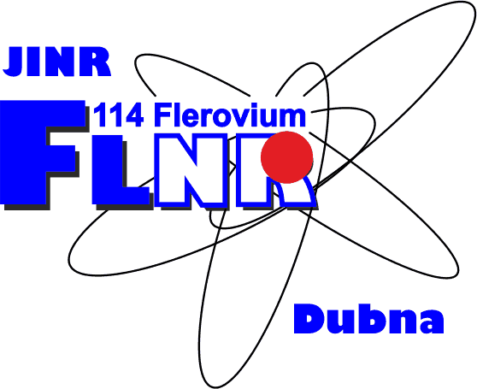
Study of elastic scattering within quantum optical model
Students: Nedelcu Cosmina Viorela
Cirstian Andreea
Supervisor : Vladimir Rachkov
University of Bucharest, Department of Physics

Slide 2
Aims of the project:
Study of the behavior of the elastic scattering cross sections of p +⁵⁸Ni at wide range of energies (from 10 MeV to 200 MeV);
Plot local systematics;
Content:
Definitions
Theoretical part :
Optical model
Optical model potential
Experimental part:
Conclusions

Slide 3
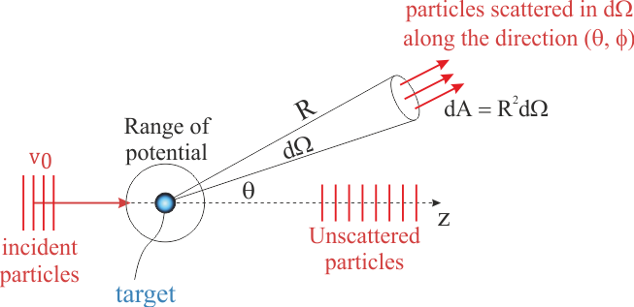
Cross-sections
The characteristics of the reactions can be summarized in distributions of cross sections
Typical unit: 1 barn=10 ⁻²⁸ m² =100 fm²
Scattering between an incident beam of particles and a ﬁxed target: the scattered particles are detected within a solid angle dΩ along the direction (ɸ;ϕ)

Slide 4
Differential cross-section
Have the dimensions of the area
Deﬁned as the number of particles scattered into an element of solid angle in the direction per unit time and incident ﬂux:
Typical unit: barn/steradian

Slide 5
Optical model
used to describe elastic scattering cross-sections
provide the wave functions needed to analyse nuclear reactions
solutions of time-independent Schrödinger equation :
with E>0
with boundary condition at infinity:
,f($θ$)=scattering amplitude

Slide 6
Optical model potential (OMP)
Defined as the potential which furnishes the energy-averaged scattering amplitudes
Equation:

Slide 7
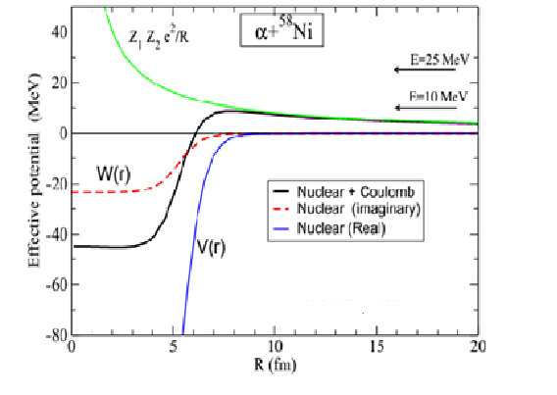
Coulomb (Rutherford) Scattering Vom=Vc
Sommerfeld parameter:
Scattering amplitude:
Differential :
cross-section
The dependence of the potential of the radius of the nuclei

Slide 8
Coulomb + Nuclear Scattering V_{OM}=V_{c}+V_{N}
Scattering amplitude:
Differential cross-section:

Slide 9
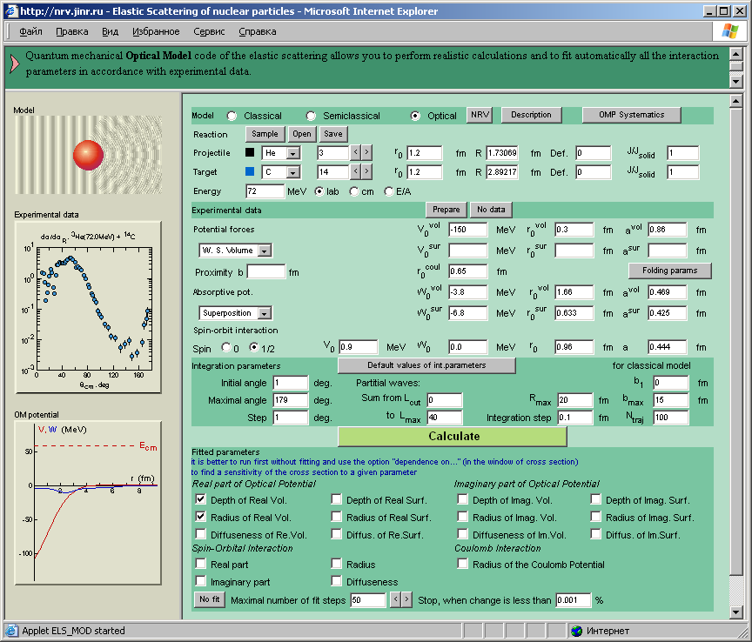
Practical part
NRV knowledge base
http://nrv.jinr.ru
The NRV web knowledge base is a unique interactive research system:
Allows to run complicated computational codes
Works in any internet browser
Has graphical interface for preparation of input parameters and analysis of output results
Combines computational codes with experimental databases on properties of nuclei and nuclear reactions
Contains detailed description of models

Slide 10
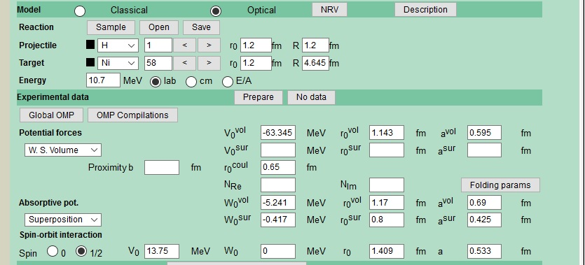
Practical part
http://nrv.jinr.ru
Optical Model calculation with NRV OM code
Main steps of calculation:
Physical
Set projectile and target parameters (mass, spin, etc)
Set the incident energy
Set the parameters of the OM potential

Slide 11
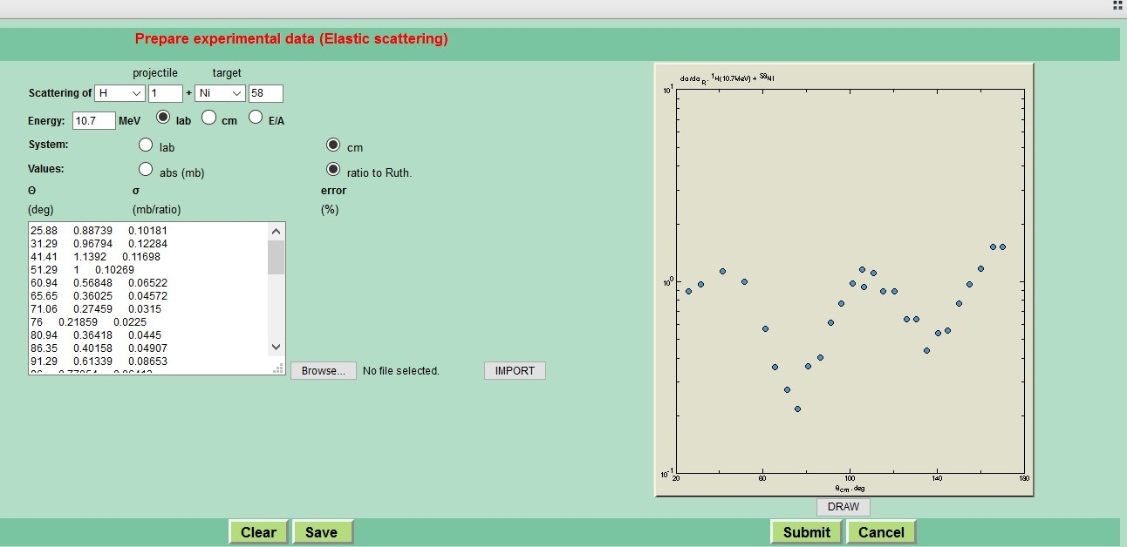
Practical part
http://nrv.jinr.ru
Prepare the experimental data

Slide 12
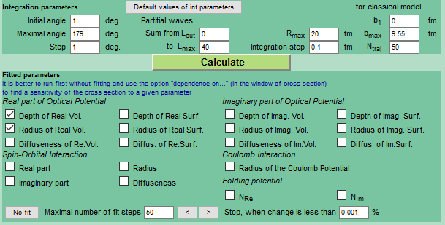
Practical part
http://nrv.jinr.ru
Optical Model calculation with NRV OM code
Main steps of calculation:
Numerical
Set the radial step for integration
Set the maximum radius R for integration
Set the maximum angular momentum L

Slide 13
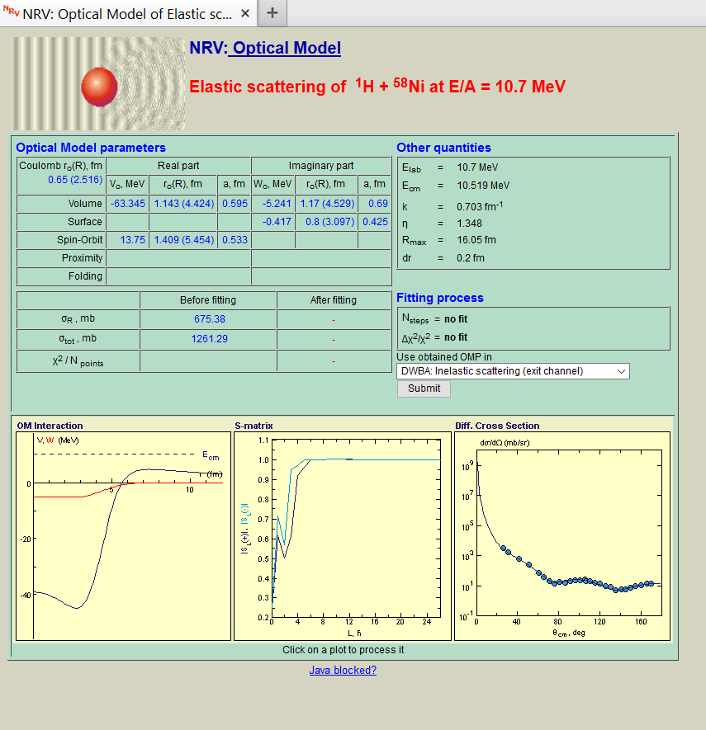

Slide 14
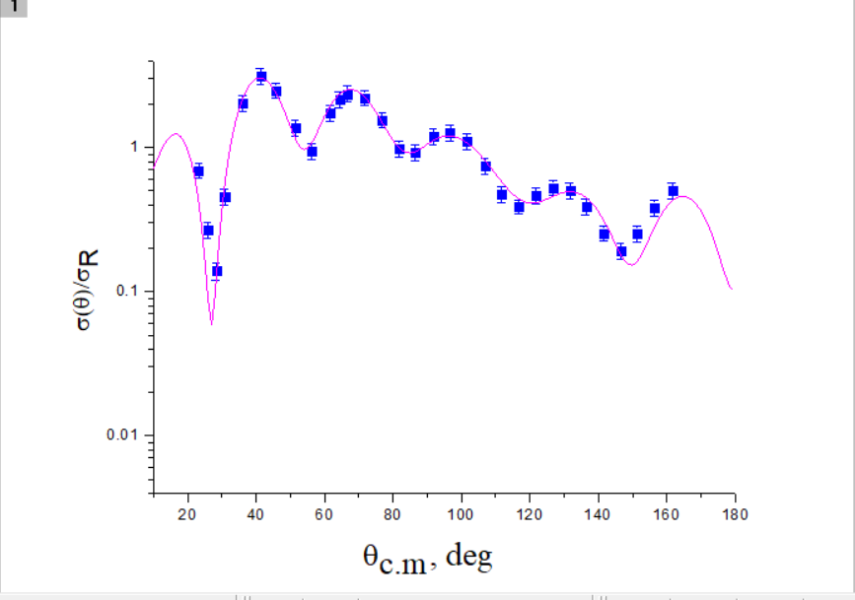
Description of the elastic scattering of proton on ⁵⁸Ni

Slide 15
Experimental data of Elastic scattering ⁵⁸Ni(p,p)⁵⁸Ni
Energy | Ref
10.7, 14.5, 15.4 | S. Kobayashi, K. Matsuda, Y. Nagahara, Y. Oda, N. Yamamuro, J. Phys. Soc. Jpn. 15 (1960) 1151.
12 | J. Beneviste, A.C. Mitchel, A.C. Fulmer, Phys. Rev. 133 (1964) B317.
16 | R.L. Varner, PhD thesis, University of North Carolina at Chapel Hill, 1986
17.8 | I.E. Dayton, G. Schranck, Phys. Rev. 101 (1956) 1358.
18.6 | P. Kossanyi-Demay, R. de Swiniarski, C. Glashauser, Nucl. Phys. A 94 (1967) 513
20.4, 24.6 | J.P.M.G. Melssen, P.J. van Hall, S.D. Wassenaar, O.J. Poppema, G.J. Nijgh, S.S. Klein, Nucl. Phys. A 376 (1982) 183.
21.3 | N. Baron, R. Leonard, D. Lind, Phys. Rev. 180 (1969) 978.
22 | C.B. Fulmer, Phys. Rev. 125 (1962) 631.
30.3 | D.L. Watson, J. Lowe, J.C. Dore, R.M. Craig, D.J. Baugh, Nucl. Phys. A 92 (1967) 193 B.W. Ridley, J.F. Turner, Nucl. Phys. 58 (1964) 497
35 | T. Eliyakut-Roshko, R.H. McCamis, W.T.H. van Oers, R.F. Carlson, A.J. Cox, Phys. Rev. C 51 (1995) 1295
39.6 | H.S. Liers, R.N. Boyd, C.H. Poppe, J.A. Sievers, D.L. Watson, Phys. Rev. C 2 (1970) 1399.
40 | L.N. Blumberg, E.E. Gross, A. van der Woude, A. Zucker, R.H. Bassel, Phys. Rev. 147 (1966) 812
61.4 | C.B. Fulmer, J.B. Ball, A. Scott, M.L. Whiten, Phys. Rev. 181 (1969) 1565
65 | H. Sakaguchi, M. Nakamura, K. Hatanaka, A. Goto, T. Noro, F. Ohtani, H. Sakamoto, H. Ogawa, S. Kobayashi, Phys. Rev. C 26 (1982) 944.
100 | K. Kwiatkowski, S. Wall, Nucl. Phys. A 301 (1978) 349.
160 | P.G. Roos, N.S. Wall, Phys. Rev. 140 (1965) B1237
178 | A. Ingemarsson, A. Johansson, G. Tibell, Nucl. Phys. A 322 (1979) 285.
200 | H. Sakaguchi, et al., RCPN Annual Report, 1993, p. 4

Slide 16
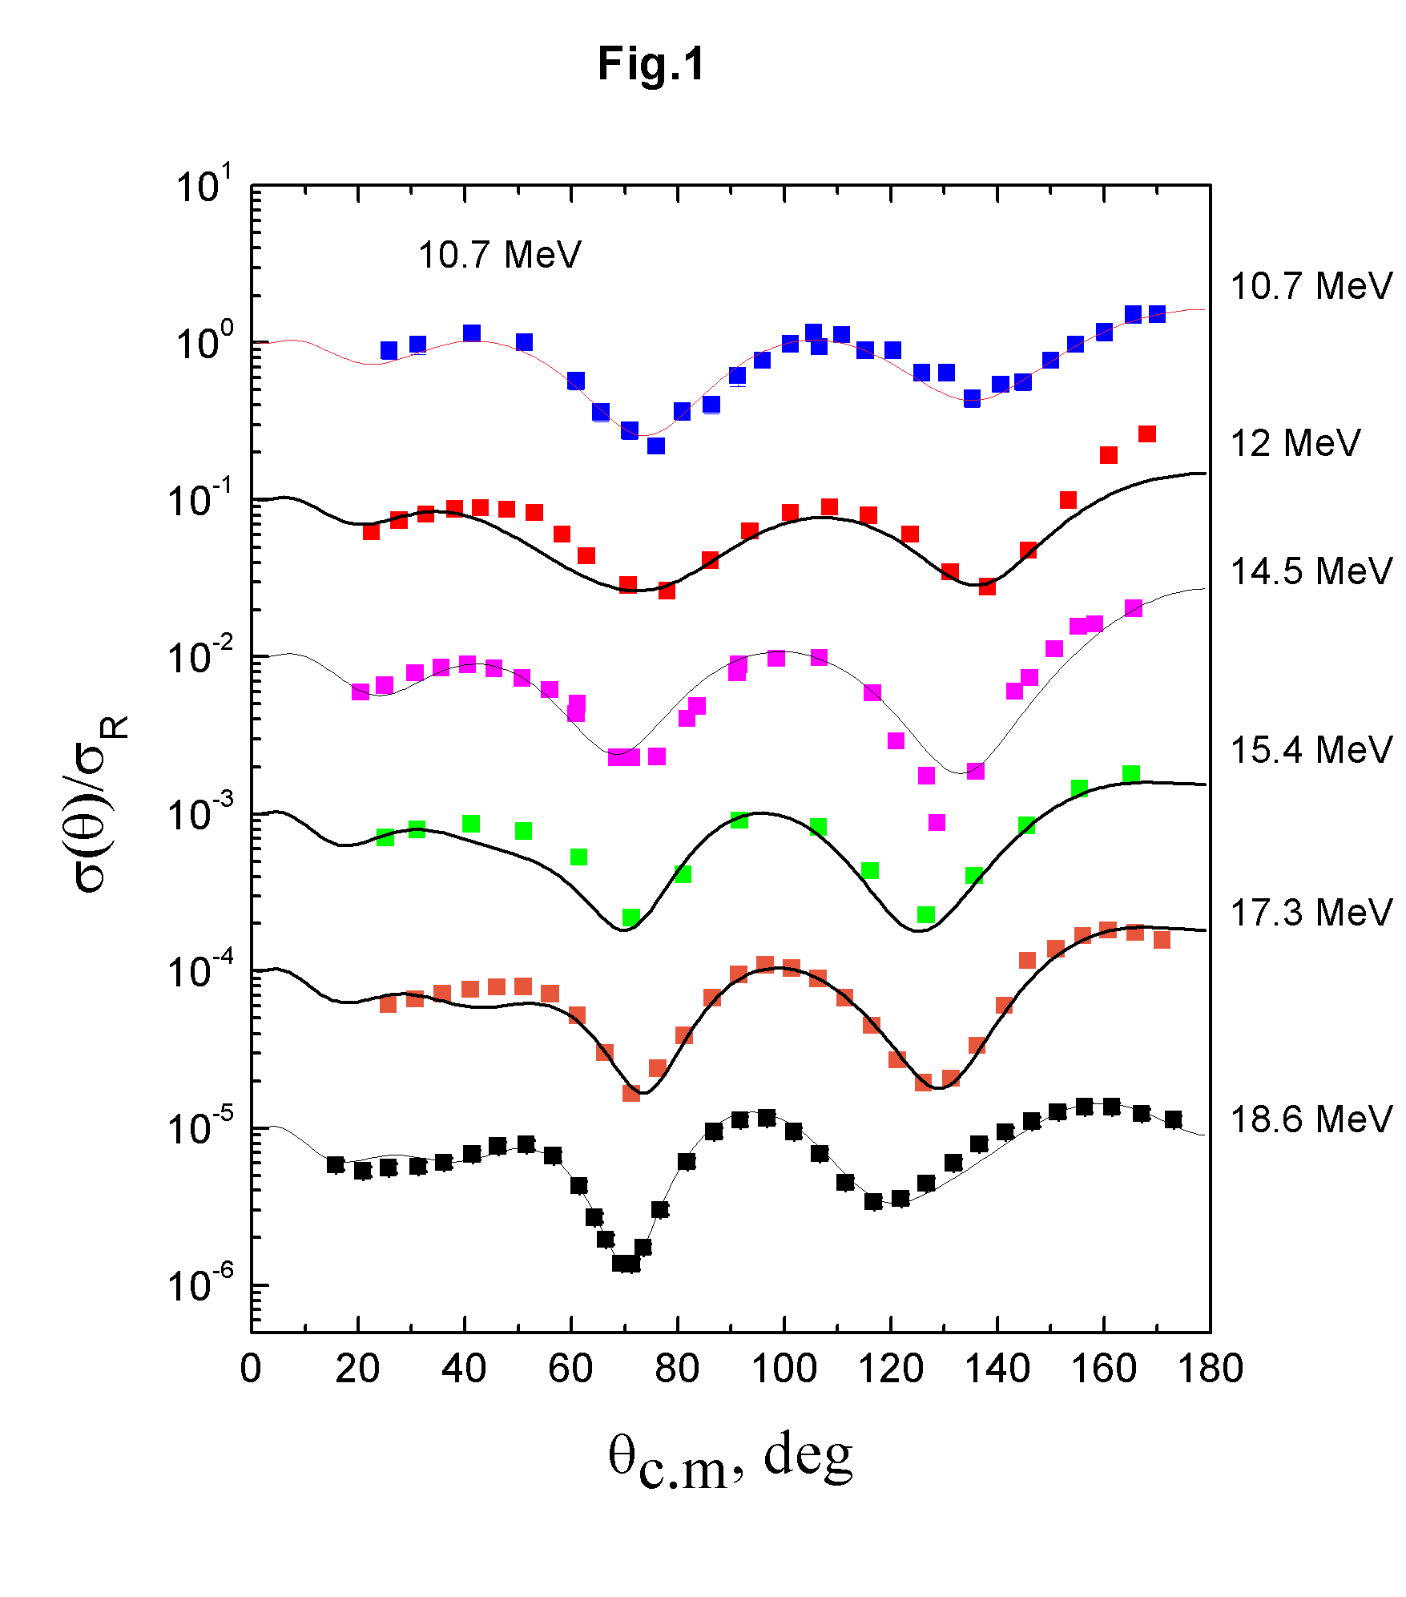
Description of the elastic scattering of proton on ⁵⁸Ni

Slide 17
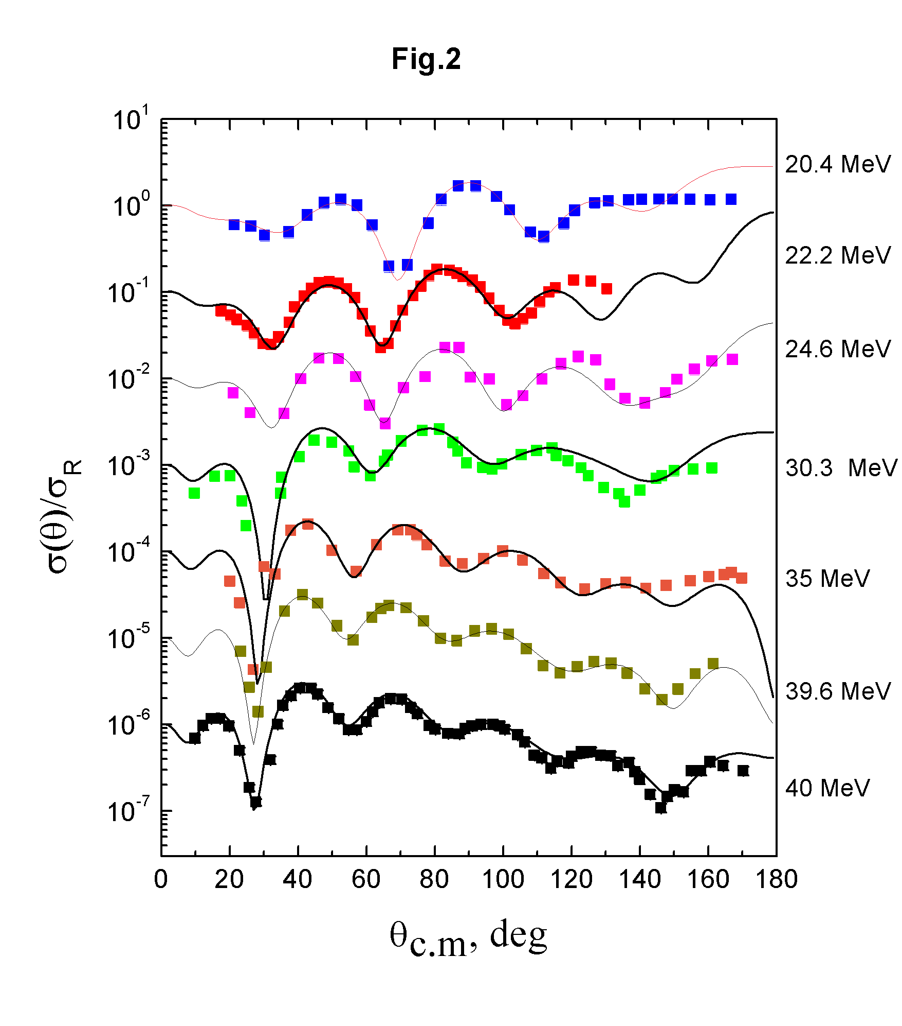

Slide 18
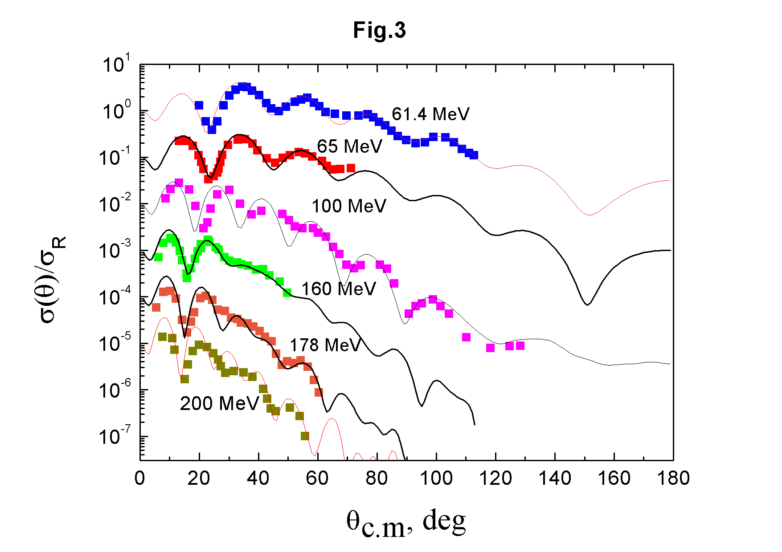

Slide 19
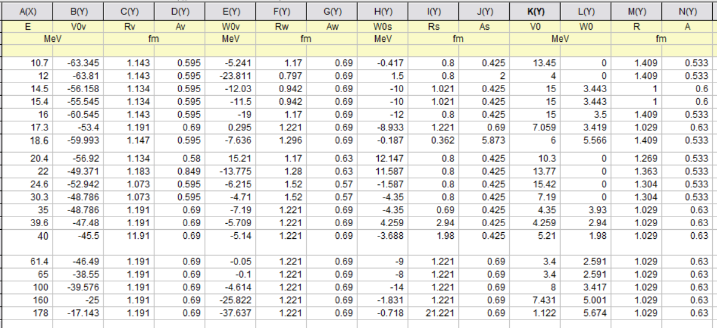
Parameters of potential

Slide 20
Conclusions
We studied the elastic scattering theory and the OM
We derived the expressions for
partial wave expansion of a plane wave
a relation between the elastic cross section and phase shifts
a relation between the scattering amplitude and the phase shifts
We applied the NRV OM code to study elastic scattering of p+ ⁵⁸Ni at different energies
We obtained parameters of OMP
Good agreement between calculation and experimental data was achieved
The next step is to plot local systematics of OMP

